Slide 1

Stock Market Data Analysis
John-Paul Besong,Dounglan Cheung,Mario Garcia, Jeremy Gavrilov, Zachary Pinter

Slide 2
Overall Concept
Impact of Covid-19 on Global Business.
Using Sentiment Analysis to predict fluctuations in stock pricing. Focusing on:
Tweets about specific companies.
Trending words when stocks spike up/down.
Correlation with these and stock prices.

Slide 3




The Chosen Ones: AAL, Zm, nflx, tsla
Airlines
Deeply impacted by travel bans.
Zoom University
Meteoric rise in online classes.
Rise regardless of alleged privacy concerns.
Netflix
Higher percentage of free time due to quarantine.
Tesla
Dropping oil prices affecting electric car sales.
Automotive industry in recent decline.
These companies have been the most trending, leading to the most Twitter data.

Slide 4
Api’s Used
Twitter – Collecting Tweets
Numpy - Twitter Data Manipulation
TextBlob – Sentiment Analysis
Panda – Stock Data Manipulation
Alpha_Vantage – Stock Data
DateTime – Live Time Tracking
MatPlotLib – Graphing Stock Data

Slide 5
The code – Twitter data

Slide 6
The code - stocks

Slide 7
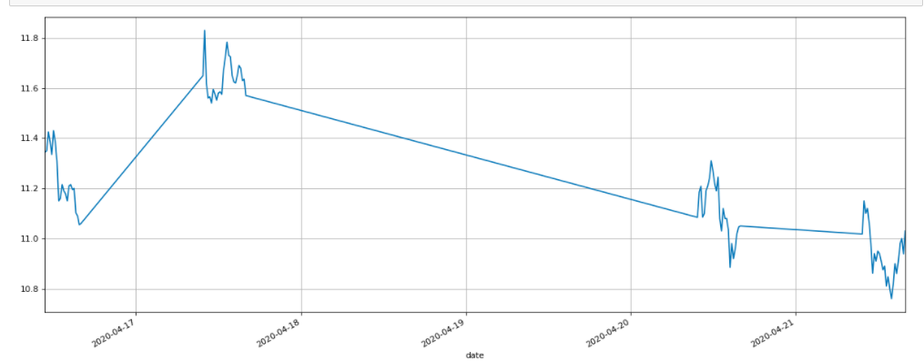
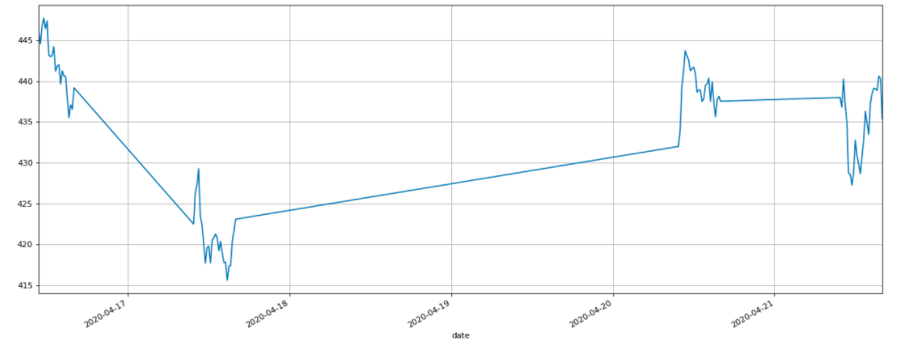
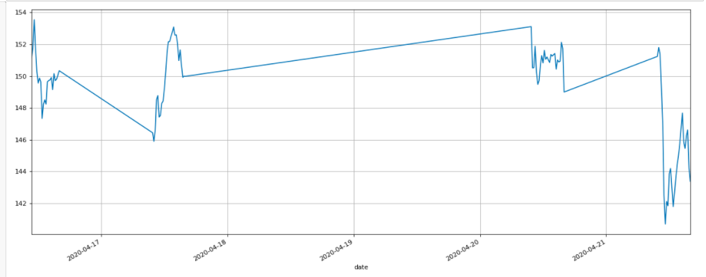
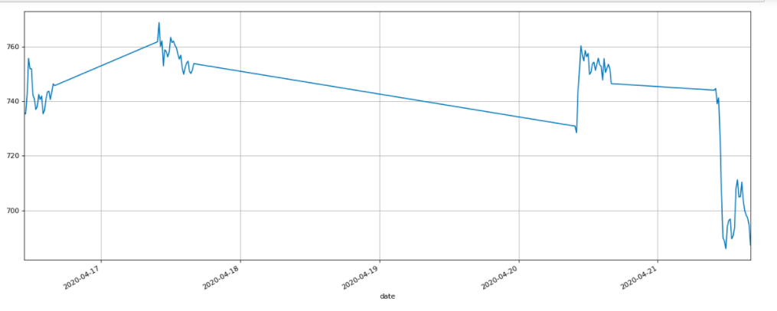
Stock data
American Airlines
Netflix
Zoom
Tesla

Slide 8
The code – Sentiment analysis

Slide 9
Twitter data

Slide 10

Demo Time!

